Slide 1
SMU RDSS Kaggle club
Presentation at SMU OIT/CRC Star meetings 9/30/22

Slide 2

WHAT IS
Kaggle is an AirBnB for Data Scientists with over 5 million unique members over more than 200 contries
Stating in Melbourne (AUS), moved to Silicon Valley (2011) and acquired by Google (2017)
Free Tutorial, Data Sets and place for Data Science competitions (with prizes)
Users learn from each other via submitted code with data

Slide 3
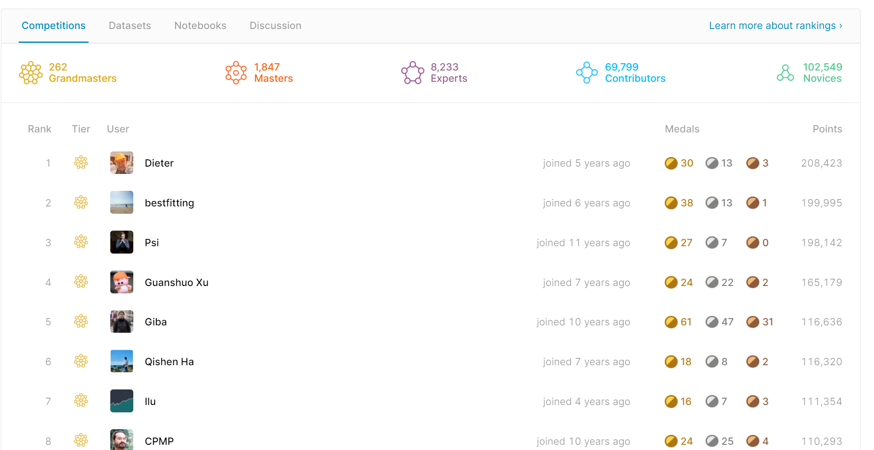
WHAT IS
Kaggle is an AirBnB for Data Scientists with over 5 million unique members over more than 200 contries
Stating in Melbourne (AUS), moved to Silicon Valley (2011) and acquired by Google (2017)
Free Tutorial, Data Sets and place for Data Science competitions (with prizes)
Users learn from each other via submitted code with data

Slide 4
Why
Most data scientists are only theorists and rarely get a chance to practice before being employed in the real-world!
Kaggle solves this problem by giving data science enthusiasts a platform to interact and compete in solving real-life problems
Many type of data in different domains, many questions you never foresee

Slide 5
HOW to
Host of competitions (Netflix for example) prepare data and detailed description
Participant (You), download the data and follow the description to write the code to solve the problem. You can revise and submit many time until reaching your desired benchmark or until the deadline of competition
After deadline, the host screen the winner based on the leader board (mostly the accuracy and time to solve the problem). Some interviews may happen.

Slide 6
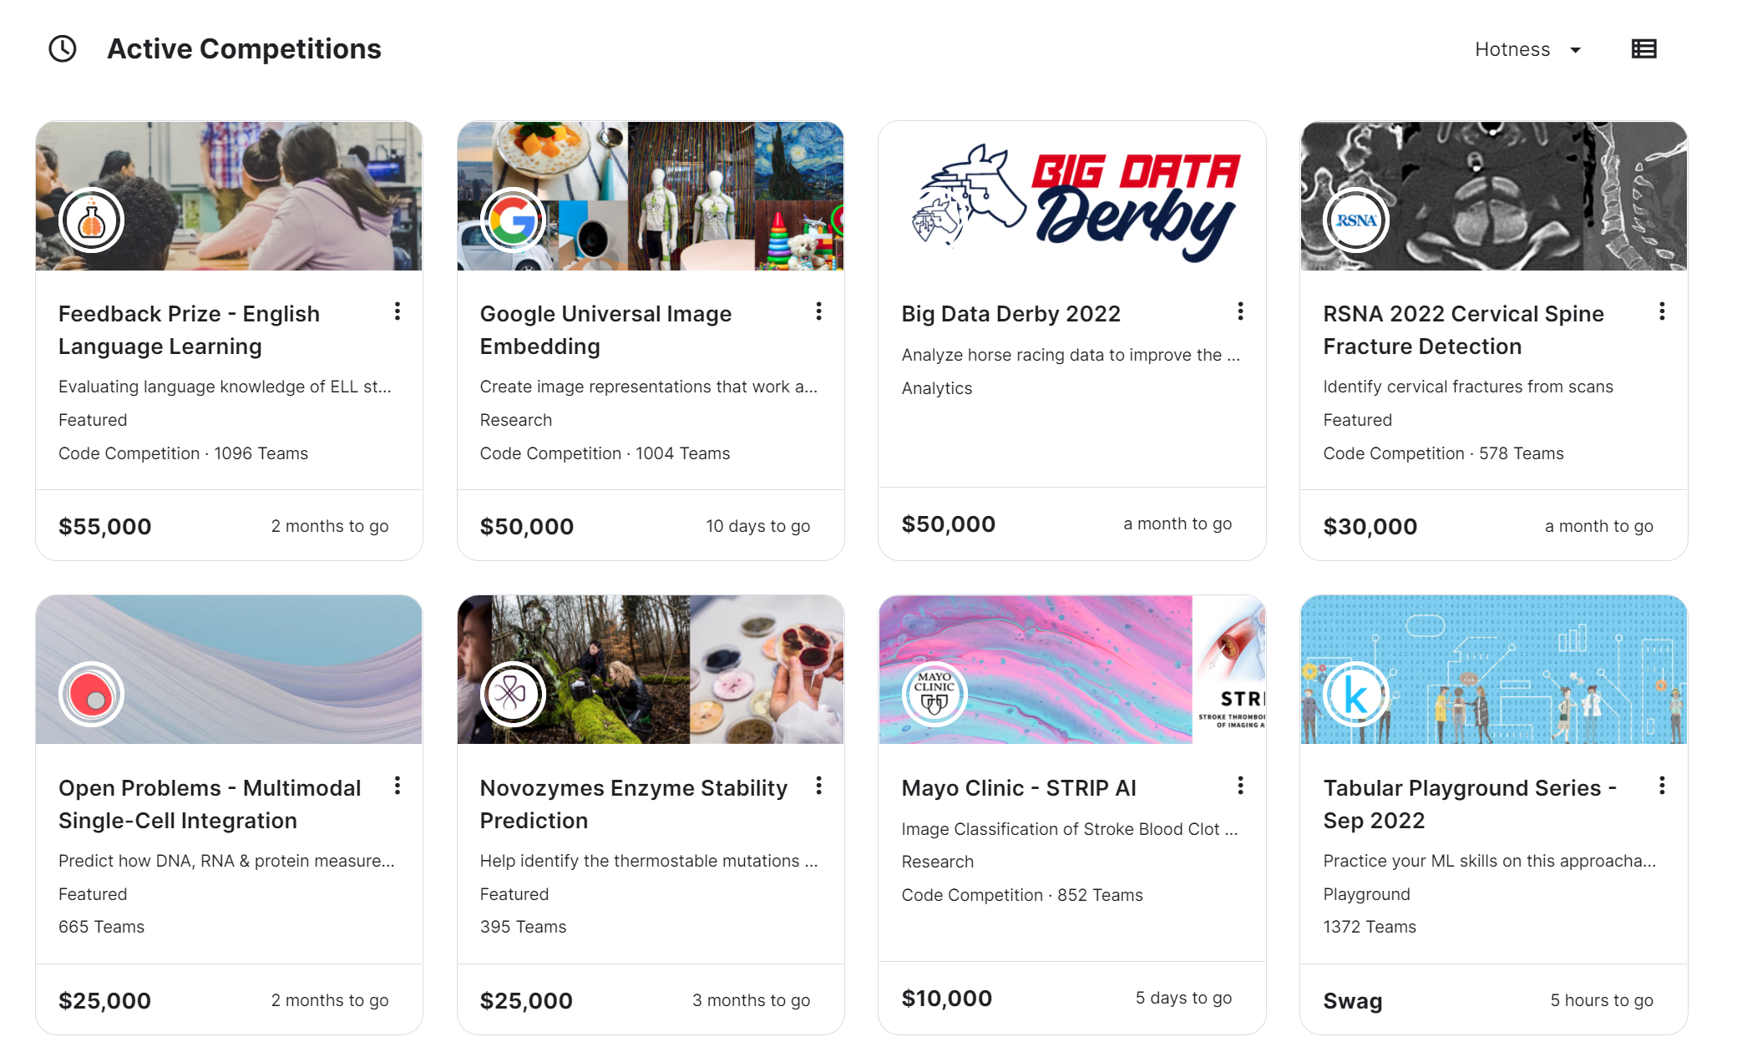
Some active competitions

Slide 7
WHAT IS SMU OIT RDSS club?
Originally created for with core members are our STAR students
Help students to learn “How to Kaggle” at SMU using HPC M2 with prebuilt Data Science workflow using R/Python
Real challenge with Kaggle datasets
Kaggle club members meet every month or 2 weeks
Students prepared the Solution to selected competitions and has the chance to practice Presentation in front of our club
Q & A will help to improve the accuracy and fine-tuning the code
Students’ works will be posted to our SMU Kaggle club page

Slide 8
Why SMU OIT RDSS club?
A great chance for Students to work with real dataset and Data Science solution from RDSS expert
Utilize M2 and SuperPOD computing power, especially with GPUs
Build up your ability and programming skill to become a real-life Data Scientist
Fine tune your presentation skill
Learn and grow from mistake
Learn from each other
Build up your Kaggle or Github portfolio
It’s 100% FREE to join and leave

Slide 9
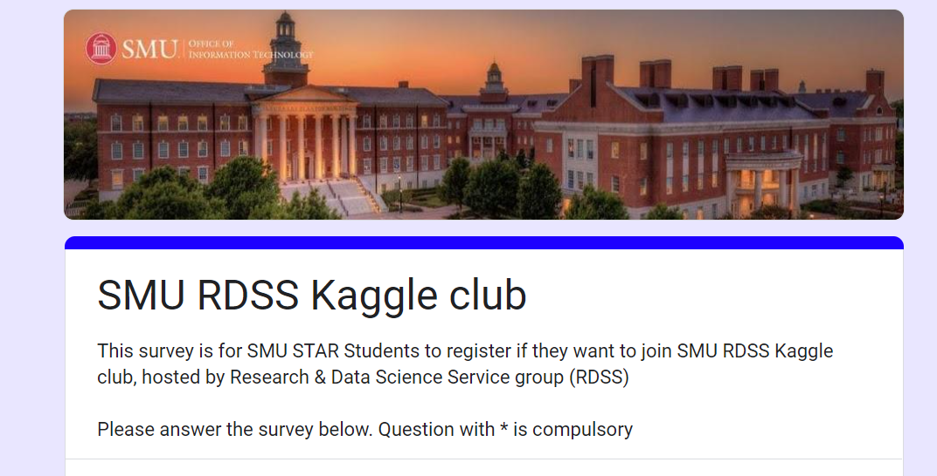
How to join SMU OIT RDSS club?
Fill in the google form:
bit.ly/SMU_RDSS_Kaggle

